Slide 1
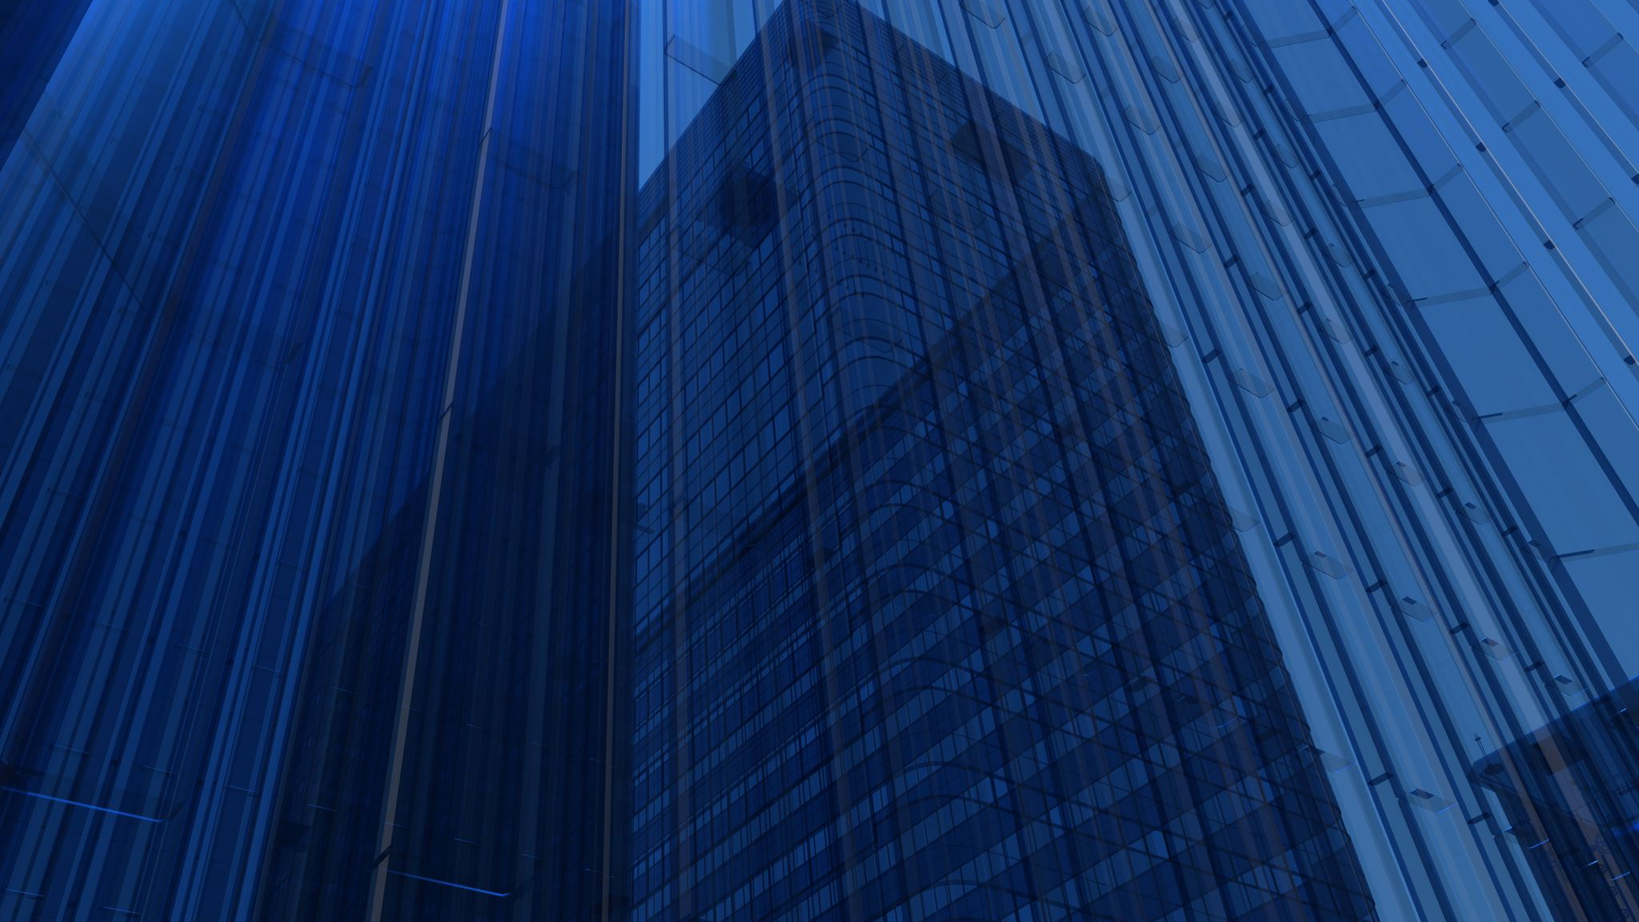
PROJECT PRESENTATION
MATH 4323
November 29, 2022
Shaheer Khan, Daniel Onitilo, Oluwatobiloba Oladunjoye

Slide 2
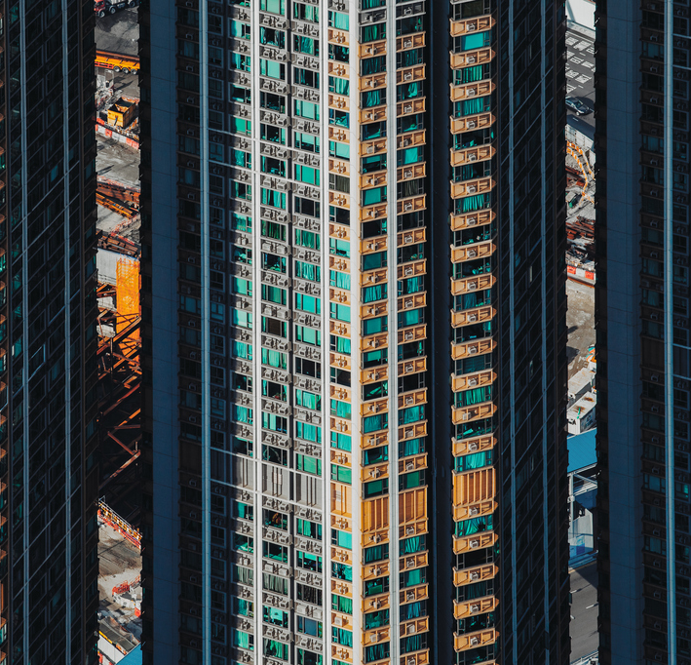
Breakdown
Background and Research goal
Dataset
Results
Conclusion
Closing

Slide 3
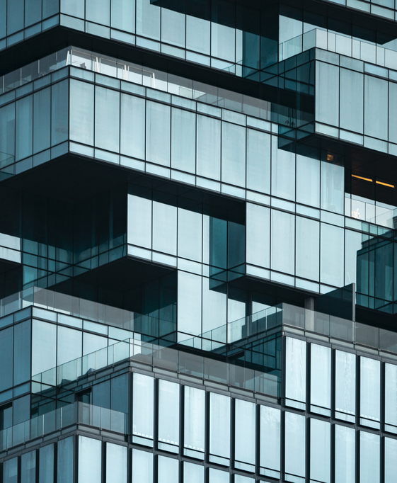
Background and Research Goal
We initially looked at a wide variety of topics, including sports, crime, and academics.
Our research centers on wage statistics across the U.S. working population.
One aspect of our research is to determine the factors that are most relevant to a person’s wage.
This is done with the aim of predicting where a random U.S. resident ranks in comparison to the median wage value.

Slide 4
Dataset
The selected dataset is the Census Income Dataset
It has 48,842 observations and 14 variables.
The 14 variables consist of 13 independent variables and 1 dependent variable.
Some variables include age, education, marital status, etc.
It is sourced from the UCI Machine Learning Repository.

Slide 5
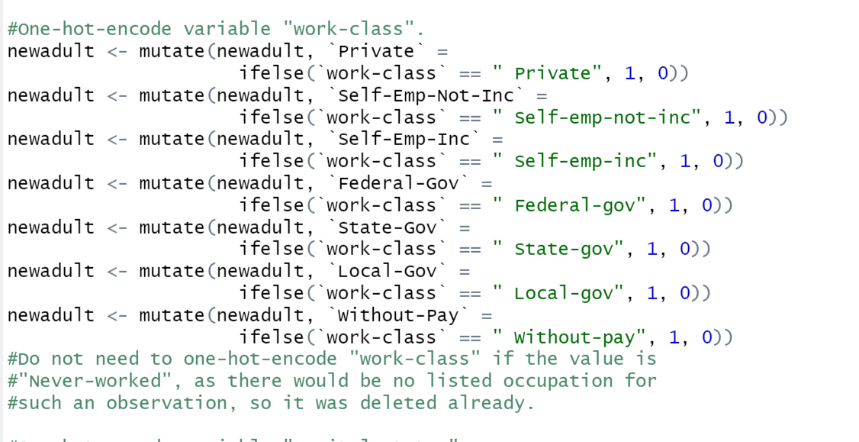
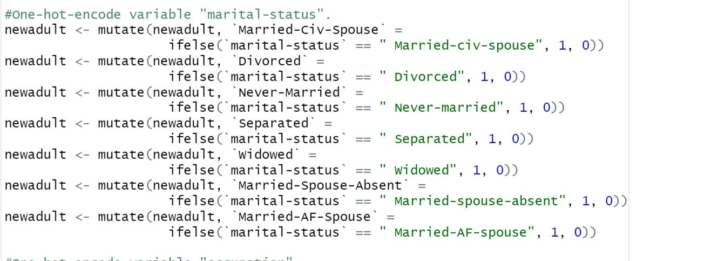
Results
We “one-hot-encoded” the data set
“Adult” was the codename assigned to the dataset
The goal of this is essentially to clean and simplify the dataset

Slide 6
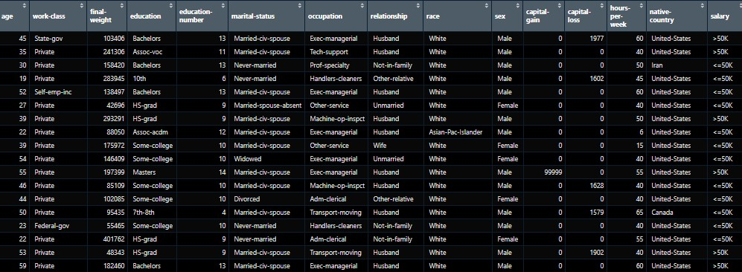
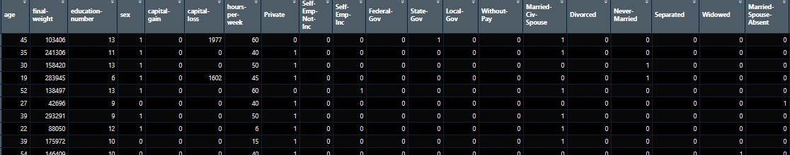
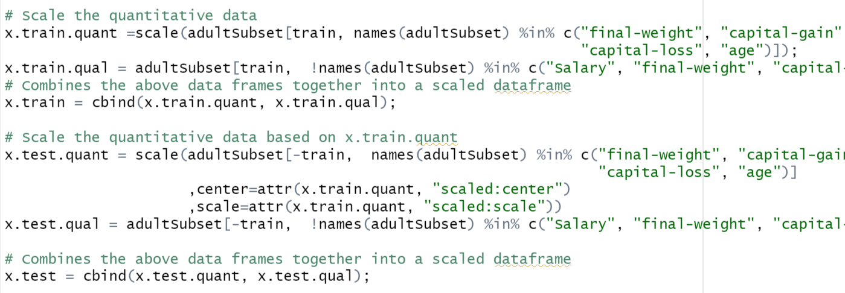
Results
Before and after visualizations of the “cleaning process”
We proceeded to scale the data set because of large scale observations such as “final-weight”, “capital gain”, and “capital loss”
This was done with the intent to normalize the data.
With this process out of the way, we proceeded to perform the KNN-Modeling

Slide 7
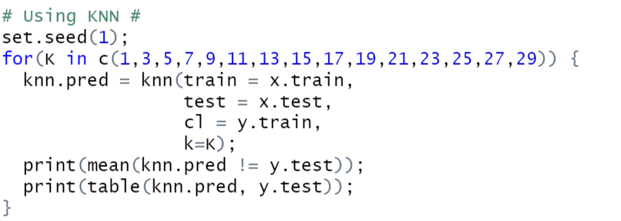
KNN Algorithm
This supervised learning approach lets us classify salaries of people in two categories: ( > 50K or < 50K)
We ran the KNN algorithm with a validation set different k values to find an optimal value.
The K-Fold cross validation approach was also implemented to evaluate the model

Slide 8
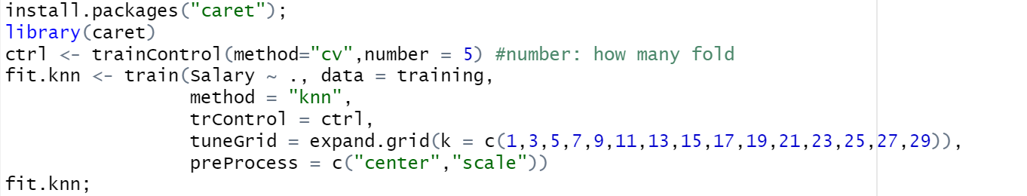
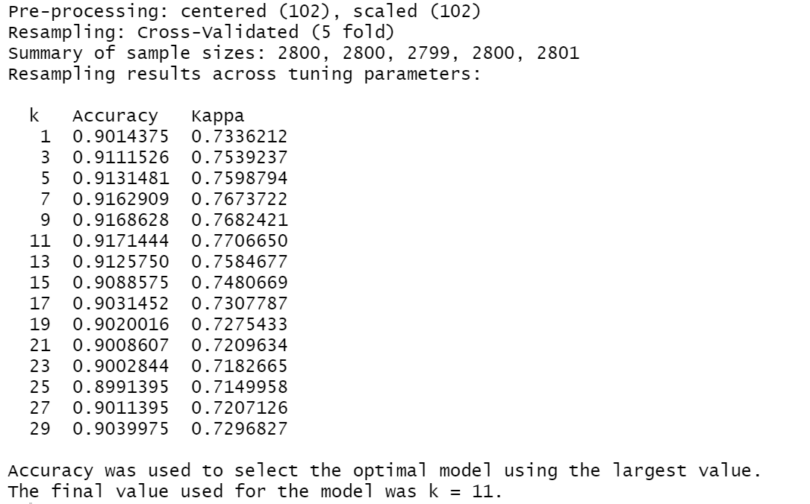
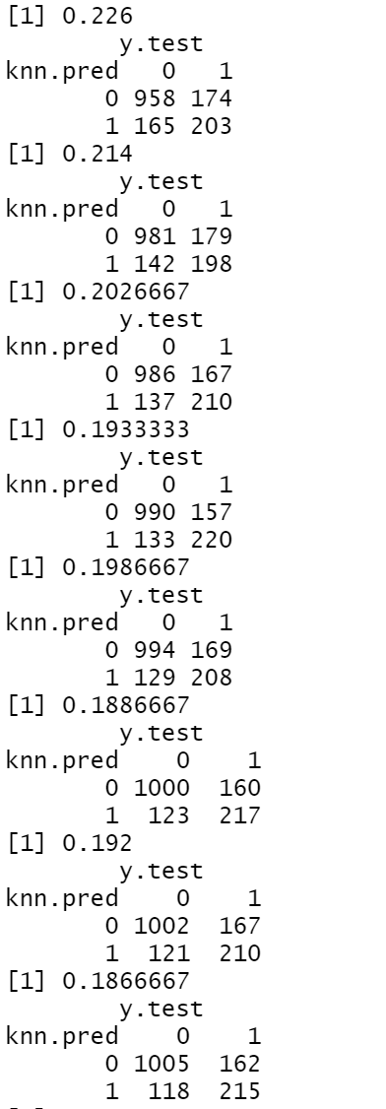
Results Obtained

Slide 9
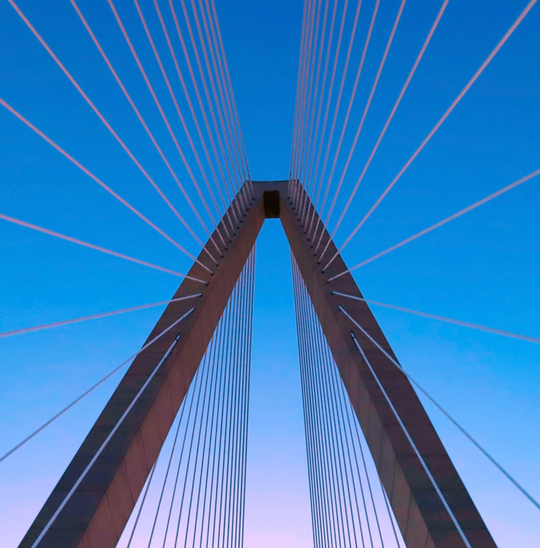
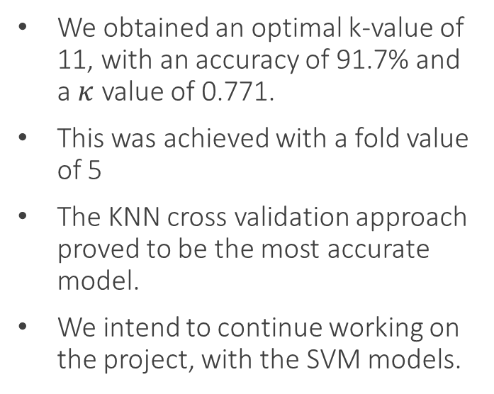
Conclusion
We obtained an optimal k-value of 11, with an accuracy of 91.7% and a $κ$ value of 0.771.
This was achieved with a fold value of 5
The KNN cross validation approach proved to be the most accurate model.
We intend to continue working on the project, with the SVM models.

Slide 10

Thank you for listening!
THE END

